Slide 1
KWAME NKRUMAH UNIVERSITY OF SCIENCE AND TECHNOLOGY, KUMASI
COLLEGE OF ENGINEERING
DEPARTMENT OF AGRICULTURAL & BIOSYSTEMS ENGINEERING
ENGINEERING IN SOCIETY
CENG 291

Slide 2
COURSE OBJECTIVES
To aid students appreciate the purpose of engineering to solve societal problems
To draw a link between agricultural engineering and its application to societal problems
To professionally and ethically prepare students for their chosen engineering field.
To develop applicable communication, reasoning and reflection skills.

Slide 3
COURSE OUTLINE
Ethics and Professionalism
Moral Reasoning and Codes of Ethics
Moral Frameworks
Commitment to Safety
Workplace Responsibilities and Rights

Slide 4
COURSE OUTLINE
Workplace Responsibilities and Rights
Honesty and Integrity
Code of Ethics and Disciplinary Procedure of Ghana Institutions of Engineers (GHIE)
The Canons of Engineering and Code of Ethics of the Professional Disciplines

Slide 5


UNIT 1 ETHICS AND PROFESSIONALISM

Slide 6
ETHICS
What are ethics?
Moral values that are sound, actions that are morally right, policies and laws that are desirable.
What are engineering ethics?
Responsibilities and rights that ought to be endorsed by those engaged in engineering, and also of desirable ideals and personal commitments in engineering.

Slide 7
ETHICS
Why study engineering ethics?
Contribute to safe and useful technological products
Gives meaning to engineers’ endeavours
Strengthens one’s ability to reason clearly and carefully about moral questions
Increases moral autonomy (self-determining or independent)

Slide 8
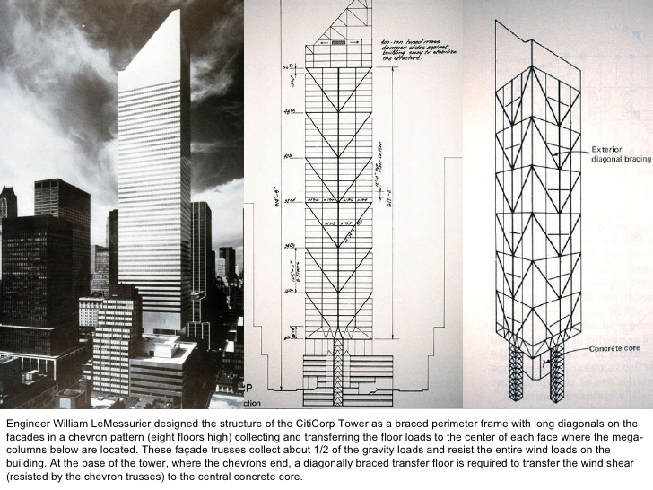
ETHICS
Accepting and Sharing Responsibility

Slide 9
ETHICS
Accepting and sharing responsibility
What does it mean to be responsible?
Obligations (the core idea around which all other senses revolve). Obligations are role responsibilities
Accountable (to be answerable to an obligation)
Conscientious (Acceptance of obligations and diligence in fulfilling them even under difficult circumstances.)
Blameworthy/Praiseworthy

Slide 10
ETHICS
How to be morally autonomous or independent.
Moral awareness
Cogent moral reasoning
Moral coherence
Moral imagination
Moral communication
Respect for persons
Integrity

Slide 11
CODE OF ETHICS OF ENGINEERS
BY ASABE
Fundamental Principles
Engineers must use their knowledge and skill for the enhancement of human welfare
Engineers must be honest and impartial, and serving with fidelity the public their employers and clients
Engineers must strive to increase the competence and prestige of the engineering profession
Engineers must support the professional and technical societies of their disciplines

Slide 12
CODE OF ETHICS OF ENGINEERS
BY ASABE
Fundamental Canons
Engineers shall:
hold paramount safety, health and welfare in the performance of duties
perform services only in the areas of competence
issue only truthful and objective public statements
continue their professional development throughout their careers
provide opportunities for development of those engineers under their supervision.

Slide 13
PROFESSIONALISM
What is a Profession?
Any occupation which provides a means by which to earn a living. It involves
Advanced expertise (theoretical and technical know-how)
Self-regulation (setting standards for admission to professions, drafting code of ethics, enforcing standard of conducts, etc.)
Concerted service to public good

Slide 14
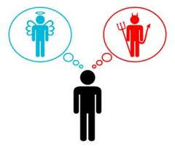
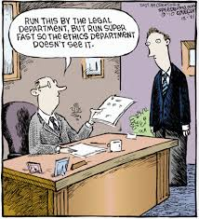
UNIT 2 MORAL REASONING AND CODES OF ETHICS

Slide 15
MORAL REASONING
Moral reasoning
A thinking process with the objective of determining whether an idea is right or wrong. Expectedly, moral reasoning should culminate in a good decision or choice.
According to John Dewey, “Choice is reasonable when it…coordinates, organizes and functions each factor of the situation which gave rise to conflict, suspense and deliberation.”

Slide 16
MORAL REASONING
Ethical (moral) Dilemmas
Situations in which moral reasons come into conflict, or in which the applications of moral values are unclear, and not immediately obvious what should be done.
Resolving Ethical Dilemmas
The outcome of a resolved ethical dilemma is:
Clear (moral clarity)
Informed (Knowing and appreciating the implications of morally and relevant available facts)
Well reasoned(good judgement on the available facts received to arrive at a morally desirable solutions).

Slide 17
MORAL REASONING
Steps in Resolving Ethical Dilemmas
The following guidelines are considerable steps that will lead to a clear, informed and well reasoned choice
Moral Clarity: Identify the relevant moral values
Conceptual clarity: Clarify key concepts
Informed about the facts: Obtain relevant information
Informed about the options: Consider all options
Well- reasoned: Make a reasonable decision

Slide 18
MORAL REASONING
Ethical Dilemmas can be divided into two main categories
Right-Wrong
These are dilemmas with solutions that are either right or wrong
Better-Worse
Dilemmas with two or more solutions, none of which is mandatory but one of which should be chosen.
Also, the NSPE board of Ethical Review provides the valuable service to apply the NSPE code to fictionalized cases which are based on actual events. The board’s rulings are available on the internet at (http://www.niee.org)

Slide 19
MORAL REASONING
Making Moral Choices
Although ethical dilemmas comprise the most difficult occasions for moral reasoning, they only constitute a small percentage of moral choices. Moral choices are decisions involving moral values. They are mostly routine and straight-forward.
The examples below entail how choices involving moral values entered into routine decisions during technological development:
Design of aluminium Cans
Design Analogy: Whitbeck

Slide 20
CODES OF ETHICS
Codes of ethics state the moral responsibilities of engineers as seen by the profession, and as represented by a professional society. Engineers must perform under a standard of professional behaviour that requires adherence to the highest principles of ethical conduct.
The Roles of the Codes of Ethics are:
Serving and protecting the public
Providing guidance
Offering inspiration
Establishing shared standards
Supporting responsible professionals
Contributing to education
Deterring wrong doing
Strengthening a profession’s image

Slide 21
CODES OF ETHICS
Limitation to Code of Ethics
The may not be able to straightforwardly address all situations.
Codes provide little guidance on the order of priority as conflict may arise.
Codes are not always the complete and final word and as such can be flawed, both by omission and commission.
Proliferation of codes

Slide 22
CODE OF ETHICS
Ethical Relativism
Ethical relativism is the theory that holds that morality is relative to the norms of one's culture. That is, whether an action is right or wrong depends on the moral norms of the “society” in which it is practiced.
Problems of Ethical Relativism
Rules out the possibility of critiquing the code of ethics of another professional society.
Gives freedom to individuals to form their own society

Slide 23
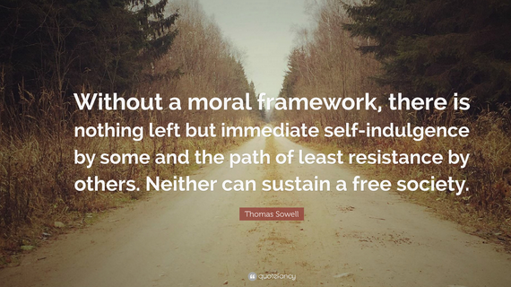
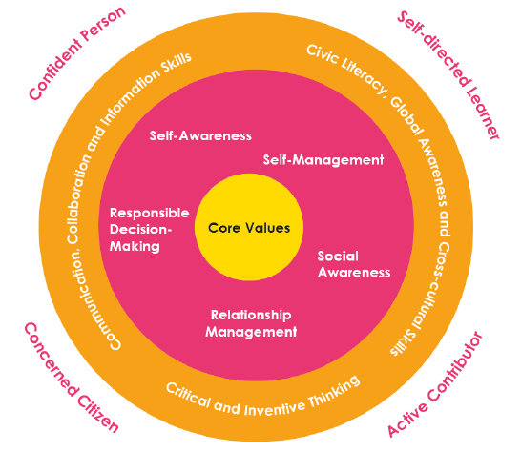
UNIT 3 MORAL FRAMEWORKS

Slide 24
MORAL FRAMEWORKS
Moral Framework
A set of ethical codes based on moral judgements that guides an individual’s behaviour in choosing a best solution for a problem.
Ethical Theory
A comprehensive perspective on morality that clarifies, organises, and guides moral reflection. It grounds the requirements in engineering codes of ethics and moral values that play a role in all areas of life.

Slide 25
MORAL FRAMEWORK
Types of Ethical Theories
Utilitarianism (maximise the overall good, accounting for those affected by actions)
Right ethics (respect for human rights)
Duty ethics (respect for individuals’ autonomy)
Virtue ethics and self realisation (good character is central to morality)
Self realisation ethics (moral significance of self fulfilment)

Slide 26
MORAL FRAMEWORK
Utilitarianism
The view to always produce the most good for the most people, giving equal consideration to everyone affected.
Cost Benefit Analysis
A systematic approach that estimates the strengths and weaknesses of alternatives and determine options that provide the best approach to achieve benefits while preserving savings.

Slide 27
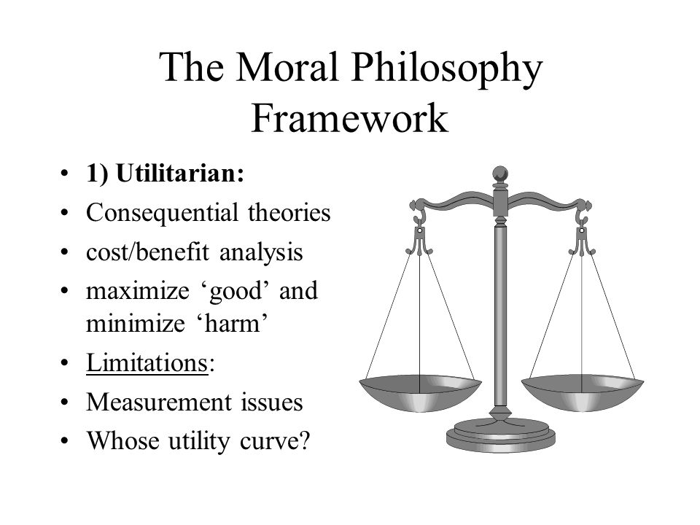
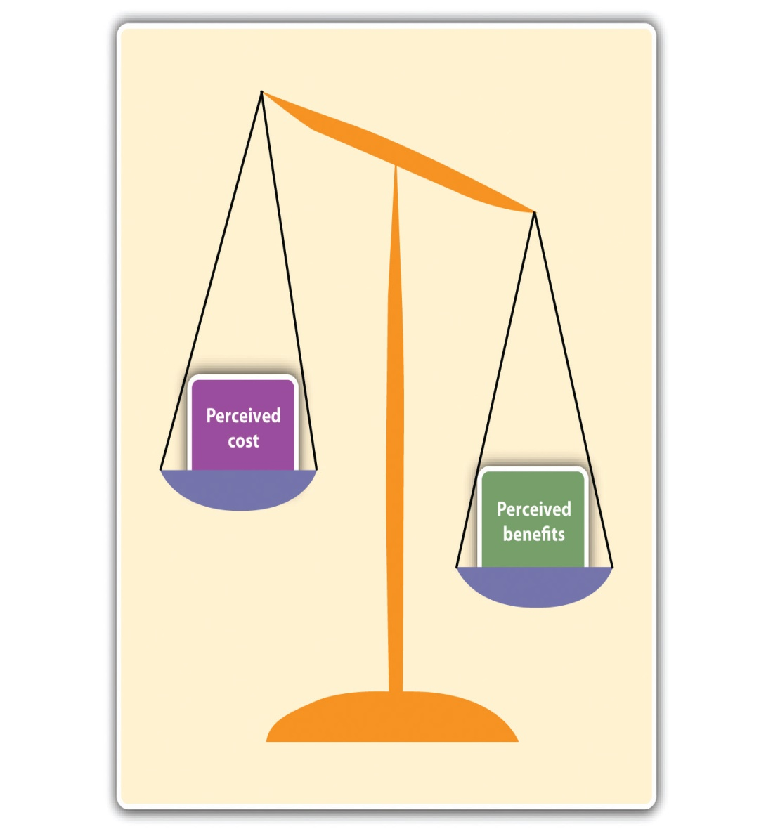
MORAL FRAMEWORK
Utilitarianism versus Cost-Benefit Analysis

Slide 28
MORAL FRAMEWORK
Utilitarianism versus Cost–Benefit Analysis
Cost-Benefit analysis sounds like utilitarianism, but often it is not.
Cost benefit analysis may usually centre around the good of a corporation, rather than the good of everyone affected, considered impartially.
Utilitarianism consider the cost and benefits to everyone affected by a project or proposal.
Utilitarianism weighs the interests of each person affected equally, giving no preference to members of a corporation.
Utilitarianism adopts a long term view and do not reduce good and bad to only money.

Slide 29
MORAL FRAMEWORK
Act-Utilitarianism
A utilitarian theory of ethics which states that a person's act is morally right if and only if it produces the best possible results in that specific situation.
Rule-Utilitarianism
A form of utilitarian theory which states that an action is right as it conforms to a rule that leads to the greatest good.

Slide 30
MORAL FRAMEWORK
Act-Utilitarianism versus Rule-Utilitarianism
Act-utilitarianism apparently permits some actions that are patently immoral but someway beneficial and causes no or little harm.
Rule-utilitarianism demonstrate that the overall good is promoted and as such do not permit actions that are not in line with principles .
Act-utilitarianism seems to permit injustice by promoting social good at the expense of individuals.
Rule-utilitarianism on the other hand emphasises the general good in heeding to rules.

Slide 31
MORAL FRAMEWORK
Right Ethics
The regard for human right as fundamental.
Duty ethics
The regard for duty of respect for autonomy as fundamental.
Both theories emphasise respect for individuals’ dignity and worth, in contrast with utilitarians’ emphasises on general good.

Slide 32
MORAL FRAMEWORK
Right ethics and duty ethics are largely mirror images of each other.
That is:
Because you have a right to life, I have a duty not to kill you.
If I have a duty not to deceive you then you have a right not to be deceived.

Slide 33
MORAL FRAMEWORK
Human Rights
These constitute a moral authority to make legitimate moral demands on others to respect our choices, recognising that others can make similar claims on us.
Holding paramount the safety, health and welfare of the public can be interpreted as having respect for public’s rights to life, rights to privacy, rights not to be injured, rights to receive benefits through fair and honest exchanges in a free marketplace.

Slide 34
MORAL FRAMEWORK
Two versions of Right Ethics
The first version conceives of human rights as intimately related to communities of people mainly welfare rights
The second version of rights ethics considers only liberty rights and denies there are welfare human rights

Slide 35
MORAL FRAMEWORK
Duty Ethics
These are right actions required by duties to respect the liberty or autonomy of individuals.
A writer suggests the following list of important duties
Don’t kill
Don’t cause pain
Don’t disable
Don’t deprive freedom
Don’t deprive pressure
Don’t deceive
Keep your promise
Don’t cheat
Obey the law
Do your duty

Slide 36
MORAL FRAMEWORK
Duty Ethics
All specific duties derive from one fundamental duty to respect persons.
Hence, respect for persons amounts to respect for their moral autonomy.
Duty ethics takes into accounts duty to oneself since the individual is rational and autonomous being (e.g. A duty not to kill oneself).
Duty ethics also considers moral duties and interprets it as “categorical imperatives” (commands requiring what is right).

Slide 37
MORAL FRAMEWORK
Prima Facie Duties
Duties that have some permissible exceptions when they conflict with more pressing duties.
Universality- moral rules apply to all rational agents
Categorical imperatives- moral rules command what is right because it is right
Absolutism-moral rules have no exceptions

Slide 38
MORAL FRAMEWORK
Virtue Ethics
Virtue ethics emphasises character as the key element of ethical thinking more than rights and values.
Virtues are the morally desirable features of an individual’s character.
Vices on the other hand are morally undesirable habits or tendencies.
Virtues may be associated with competence, honesty, courage, fairness, loyalty and humility
Vices may be associated with incompetence, dishonesty, cowardice, unfairness, disloyalty and arrogance.

Slide 39
MORAL FRAMEWORK
Virtues in Engineering
The most comprehensive virtue of engineers is responsible professionalism. This umbrella virtue implies four categories of virtues:
Public well being( public spirited virtue focusing on the good of clients)
Professional competence(virtues of mastery of profession and technical skills that characterises a good engineer)
Cooperative practices( team work virtues enabling successful work with other people)
Personal integrity( self governance virtues are those necessary in exercising responsibility).

Slide 40
MORAL FRAMEWORK
Self Realisation Ethics
This gives greater prominence to self interest and to personal commitments that individuals develop. There are two versions to this depending on how the self is conceived.
The first, ethical egoism, conceived in a highly individualist manner.
In the second, the self is understood in terms of caring relationships and communities.

Slide 41
MORAL FRAMEWORK
Ethical Egoism
Ethical egoism says that each of us ought always and only to promote our own self interest.
The theory is ethical because it is a theory about morality.
It is egoistic because it says the sole duty of each of us is to maximise our well-being.
Psychologically we are all egoistic.
Here are two arguments to support and refute psychological egoism.

Slide 42
MORAL FRAMEWORK
Argument 1
We always act on our own desires; therefore, we always and only seek something for ourselves, namely the satisfaction of our desires
In reply, the premise is true: we always act on our own desires. Actions are motivated by desires together with beliefs about to satisfy those desires. When we desire goods for ourselves, we are self-seeking; but when we desire goods for other people(for their sake), we altruistic.
The mere fact that in both instances we act on our own desires does nothing to support psychological egoism

Slide 43
MORAL FRAMEWORK
Argument 2
People always ask for pleasures, therefore they always and only seek something for themselves, namely their pleasures.
In reply, there are different sources of pleasures. Taking pleasure in seeking and getting a good solely for oneself is different from taking in helping others.

Slide 44
MORAL FRAMEWORK
Motives of engineers
Engineers are motivated by self-interest, but they are also capable of responding to moral reasons in their own right as well as additional motives concerned with the particular nature of their work. Motives can be categorised into:
Proficiency motives (centre on excellence, technical standards together with aesthetic values of beauty)
Compensation motives (social rewards such as income, power, recognition and job or career stability)
Moral motives (desires to meet one’s responsibilities and to respect the right of others).

Slide 45
MORAL FRAMEWORK
What Ethical Theory is Best?
Ethical theories are attempts to provide clarity and consistency, systematic and comprehensive understanding, and helpful practical guidance in moral matters.
Sound ethical theories succeed in meeting these aims because sound ethical theories are:
Clear and coherent
Organises basic moral values in a systematic and comprehensive way
Provides helpful guidance that is compatible with our most carefully considered moral convictions

Slide 46

COMMITMENT TO SAFETY
According to William W. Lowrance, a thing is “safe” if its risks are judged to be acceptable. As such safety can be judged to be relative, as can risk. For instance, a power saw in the hands of a child will never be as safe as it can be in the hands of an adult.

Slide 47
COMMITMENT TO SAFETY
Accidents which occur at our various engineering agencies point out how vulnerable our intricate machines and control systems can be, and how they can malfunction because of unanticipated circumstances and as such how important it is to design for proper human-machine interactions as far as safety is concerned.
Absolute safety, in the senses of
entirely risk-free activities and products
a degree of safety that satisfies all individuals or groups under all conditions,
is neither attainable nor affordable, yet it is important we come to some understanding of safety.

Slide 48
COMMITMENT TO SAFETY
Lowrance’s definition of safety needs to be modified for it departs too far from our common understanding of safety. According to Lowrance, once the risks are acceptable, then it is known to be safe. Consider these situations:
A case where we seriously underestimate the risks of something, say of buying a smartphone from a shop, only to go home and realize it was faulty and had a broken screen. On the basis of a mistaken view that buying from a shop renders the product genuine, we judge it to be safe, thus concluding we were wrong in our earlier judgement.

Slide 49
COMMITMENT TO SAFETY
A case where we grossly overestimate the risks of something. For example, we irrationally think flouride in drinking water will kill a fifth of the populace. According to Lowrance, the flouridated water is unsafe, since we judge the risks to be unacceptable. It would be impossible for someone to reason with us that the water is actually safe.
Finally, a situation in which a group makes no judgement at all about whether the risks of a thing are acceptable or not-they simply do not think about it. By Lowrance’s definition, the thing is neither safe nor unsafe with respect to that group. For example, some cars are considered safe and others unsafe, yet many people drive without thinking about the safety of the cars.

Slide 50
COMMITMENT TO SAFETY
Because little in life, and nothing in engineering is risk-free, a modified version of Lowrance’s definition is preferred.
A thing is safe if, where its risks fully known, those risks would be judged acceptable by a reasonable person in light of their settled value principles.
From this explanation, safety can now be described as how people would find risks acceptable or unacceptable if they knew the risks and were basing their judgements on their most settled value perspectives. For example, when we say an airplane travel is safer than automobile travel, we say that based on the fewer risks of death and injuries of airplane travel to automobile travel.

Slide 51
COMMITMENT TO SAFETY
Risks
A risk is the potential that something unwanted and harmful may occur. A risk is taken when we undertake something or use a product that is not safe.
Risks are somewhat unavoidable as a result of technology’s influence on society.
Some risks may be considered to be new but many have existed for some time. They are considered new only in the sense that:
They are now identifiable-because they have passed their accumulation threshold in our environment
The publics perception of them has changed-because of education, experience, media attention, etc.

Slide 52
COMMITMENT TO SAFETY
Acceptability of Risk
According to William D. Rowe, a risk is acceptabe when those affected are no longer(or not) apprehensive about it. Apprehensiveness depends to a large extent on how the risk is perceived. This is influenced by factors such as:
Whether the risk is accepted voluntarily
The effects of knowledge on how the probabilities of harm are identified.
Whether the effects are immediately noticeable or close at hand.
Whether the potential victims are identifiable beforehand.

Slide 53
COMMITMENT TO SAFETY
Illustration of the elements of risk perception.
Voluntarism and Control
People are much less apprehensive about the risks to which they expose themselves voluntarily than about those to which they are exposed involuntarily. People are more willing to be subject of their own experiments than of someone else’s.
Effect of Information on Risk Assessments
The manner in which information necessary for decision making is presented can greatly influence how risks are perceived.

Slide 54
COMMITMENT TO SAFETY
Job Related Risks
Exposure to risk on a job, although voluntary since one can always refuse to submit oneself to the job, yet often employees have little choice other than to do as they are told. What they are often not told is their exposure to toxic substances and dangers that are not readily sensed.
Magnitude and Proximity
Our reaction to risk is affected by the dread of a possible mishap, in terms of magnitude and of the personal relationship we have with the victims. For example, as we feel much more keenly about a potential risk to a close friend out of a group of 20 intimate friends than to 50 strangers.

Slide 55
COMMITMENT TO SAFETY
Assessing and Reducing Risk
Improvement in safety of an engineered product results in an increase in the cost of the product. On the other hand, unsafe products also incur secondary costs to the manufacturer beyond primary production costs such as
Warranty expenses
Loss of good customer goodwill
Loss of customers because of sustained injuries from the use of the product
Litigation
Possible downtime in the manufacturing process

Slide 56
COMMITMENT TO SAFETY
Risk-Benefit analysis
Many large projects are justified on the basis of a risk-benefit analysis. The question answered by such are study are:
Is the product worth the risks connected with its use?
What are the benefits?
Do they outweigh the risks?
If the risks and benefit can both be readily expressed in a common set of units, it is easy to carry out a risk-benefit analysis. However, it is more difficult to proceed when the analysis cannot be added in a common set of units, for instance assessing the effects of health, plus aesthetics plus reliability? Since these units vary from each other, it becomes relatively difficult to do a risk benefit analysis.

Slide 57
COMMITMENT TO SAFETY
As such, in order to do a risk-benefit analysis, one can compare designs that satisfy some constriants and try to compare the aesthetic values with those constraints, or when the risks can be expressed and measured in one set of units, and benefits in another, we can use the ratio of risks to benefits for different designs. Like cost-benefit analysis, risk-benefit analysis is concerned with the advisability of undertaking a project.

Slide 58


WORKPLACE RESPONSIBILITIES AND RIGHTS

Slide 59
WORKPLACE RESPONSIBILITIES AND RIGHTS
Workplace
Engineers need the opportunity to perform responsibly at their workplaces thus their professional rights must be observed.
This unit looks at:
Teamwork
Confidentiality
Conflicts of interest
Professional rights
Employee rights
Whistleblowing

Slide 60
WORKPLACE RESPONSIBILITIES AND RIGHTS
Teamwork
The combined action of a group of people often resulting in an effective or efficient solution.
The following teamwork virtues are important in engineering:
Loyalty to corporations
Respect for authority
Collegiality
Teamwork virtues

Slide 61
WORKPLACE RESPONSIBILITIES AND RIGHTS
Ethical Corporate Climate
A working environment that is conducive to morally responsible conduct. It is produced by a combination of:
Formal organisation and policies
Informal traditions and practices
Personal attitudes and commitments

Slide 62
WORKPLACE RESPONSIBILITIES AND RIGHTS
Features of an Ethical Corporate Climate
Acknowledgement and appreciation of ethical values in in their full complexity by managers and employees alike.
The honest use of ethical language as a legitimate part of corporate dialogue.
Top management sets a moral tone in words, in policies and by personal example.
Existence of a procedure for conflict resolution.

Slide 63
WORKPLACE RESPONSIBILITIES AND RIGHTS
Loyalty
Loyalty to an employer can mean two things:
Agency-Loyalty (acting to fulfil one’s contractual duties to an employer).
Agency-Loyalty is entirely a matter of actions, such as doing one’s job and not stealing from one’s employer regardless of the motives behind it.
Attitude-Loyalty (deals with attitudes, emotions, and a sense of personal identity as it does with actions).
Attitude-Loyalty is often a virtue but not strictly an obligation.

Slide 64
WORKPLACE RESPONSIBILITIES AND RIGHTS
Collegiality
A kind of connectedness grounded in respect for professional expertise and in a commitment to goals and values of the profession.
The central elements of collegiality includes
Respect for colleagues (valuing their professional expertise).
Commitment (devotion to the moral ideals inherent in one’s profession).
Connectedness (participating in cooperative projects based on shared commitments and mutual support).

Slide 65
WORKPLACE RESPONSIBILITIES AND RIGHTS
Managing Conflicts
Managers have the authority and responsibility to resolve or prevent damaging conflicts that threaten corporate efficiency.
Conflict resolution often aimed at maintaining teamwork is a responsibility of all engineers.
Common conflicts confronted by engineering project managers are:
Conflicts over schedules
Conflicts over importance of projects and departments
Conflicts over personnel resources
Conflicts over technical issues
Conflicts over administrative procedures
Personality conflicts
Conflicts over costs

Slide 66
WORKPLACE RESPONSIBILITIES AND RIGHTS
Applicable Principles For Conflict Resolution
People: Separate the people from the problem (personal aspect of conflicts is distinguished from the problem).
Interests: Focus on interest not on positions (attention is placed on interest of personnel not position held by personnel).
Options: Generate a variety of possibilities before deciding what to do(solutions are not compromises that split differences between stated positions).
Criteria: Insist that the result be based on some objective standard (clear general standards should be used in evaluating results)

Slide 67
WORKPLACE RESPONSIBILITIES AND RIGHTS
Confidentiality
The duty of confidentiality is the duty to keep secret all information deemed desirable to keep secret.
Basically, it any information that the employer or client would like to have kept secret in order to compete effectively against business rivals.
Related terms to confidentiality are:
Privileged information( available only on basis of special privilege)
Proprietary information(trade secret, an information a company owns)
Patents (legally protects specific products from being manufactured)

Slide 68
WORKPLACE RESPONSIBILITIES AND RIGHTS
Confidentiality and Changing Jobs
The obligation to protect confidential information does not cease when employees change jobs.
The relationship of trust between employer and employee in regard to confidentiality continues beyond the formal period of employment.
Unless the employer gives consent, former employers are barred indefinitely from revealing trade secrets.
Thus, the professional integrity of engineers involves much more than mere loyalty to one’s present employer.

Slide 69
WORKPLACE RESPONSIBILITIES AND RIGHTS
Confidentiality: Justification
The primary justification is to respect the autonomy of individuals and corporations and to recognise their legitimate control over some private information concerning themselves.
Without that control, they could not maintain their privacy and protect their self interest insofar as it involves privacy.
Confidentiality has its limits, particularly when it is invoked to hide misdeeds.
Thus confidentiality will loose it bounds, when it is needed to unveil truth about white-collar crimes.

Slide 70
WORKPLACE RESPONSIBILITIES AND RIGHTS
Conflicts of interest
Professional conflicts of interest are situations where professionals have interest that, if pursued, might keep them from meeting their obligations to employers or clients.
Conflicts of interest can arise in the following ways:
Gifts, bribes, and kickbacks
Interest in other companies
Insider information

Slide 71
WORKPLACE RESPONSIBILITIES AND RIGHTS
Gifts, bribes and kickbacks
Bribes are substantial amount of money or goods offered beyond a stated business contract with the aim of winning an advantage or keeping the contract, and where the advantage is unfair or otherwise unethical.
Gifts are not bribes as long as they are small gratuities offered in the normal conduct of business.
Kickbacks are prearranged payments made by contractors to companies or their representatives in exchange for contracts actually granted.

Slide 72
WORKPLACE RESPONSIBILITIES AND RIGHTS
Interest in other companies
This consist of having an interest in a competitor’s or subcontractor’s business.
An example is partial ownership or substantial stockholdings in the competitor’s business.
A conflict of interest will arise when one’s job involves granting contracts to that subcontractor.
Moonlighting (working in one’s spare time for another company) creates conflict of interest only in special circumstances such as working for competitors, suppliers, or customers.

Slide 73
WORKPLACE RESPONSIBILITIES AND RIGHTS
Insider Information
A sensitive conflict of interest consisting in using “inside” information to gain an advantage or set up a business opportunity for oneself, one’s family, or one’s friends.
The information might concern one’s own company or another company which one does business.
Owning stock in the company for which ones works is not objectionable, and this is often encouraged by employers.

Slide 74
WORKPLACE RESPONSIBILITIES AND RIGHTS
Rights of Engineers
As employees, engineers have rights including:
Right to receive one’s salary
Right to engage in the non-work political activities of one’s choosing without coercion from employers
As professionals, engineers have special rights that arise from their professional role and the obligation it involves. These include:
The basic right of professional conscience
The right of conscientious refusal
The right of professional recognition

Slide 75
WORKPLACE RESPONSIBILITIES AND RIGHTS
Right of professional conscience
This is a moral right to exercise professional judgement in pursuing professional responsibilities.
Pursuing those responsibilities involves exercising both technical judgement and reasoned moral convictions.
The right of professional conscience implies more specific rights, corresponding to specific professional obligations.
This right has limits, and must be balanced against responsibilities to employers and colleagues.

Slide 76
WORKPLACE RESPONSIBILITIES AND RIGHTS
Right Of Conscientious Refusal
The right of conscientious refusal is the right to refuse to engage in unethical behaviour and to refuse do so solely because one views it as unethical.
This is a kind of second-order right.
Engineers have a moral right to participate in activities that are illegal and clearly unethical
Engineers have a limited right to turn down assignments that violate their personal consciences in matters of great important such as threats to human life.

Slide 77
WORKPLACE RESPONSIBILITIES AND RIGHTS
Right to Recognition
Engineers have a right to professional recognition for their work and accomplishments.
Parts of this involves fair monetary remuneration, and part nonmonetary forms of recognition.
It serves as basis for criticising the unfairness of patent arrangement that fail to give more than nominal rewards to the creative engineers who make the discoveries leading to the patents.
The right to recognition, and especially fair remuneration is not only a matter of self interest but also a matter of morality too.

Slide 78
WORKPLACE RESPONSIBILITIES AND RIGHTS
Employee Rights
These are any rights, moral or legal, that involve the status of being an employee. They include:
Institutional rights (created by organisational policies)
Employments agreements (such as right to be paid the salary specified in one’s contract)

Slide 79
WORKPLACE RESPONSIBILITIES AND RIGHTS
Corporations, institutions and workplaces ought to recognise a basic set of employee rights which may include:
Privacy (right to pursue outside activities).
Equal opportunity: non-discrimination (the right not to be discounted because of gender, race, skin colour, age etc.).
Equal opportunity: sexual harassment (the unwanted imposition of sexual requirements in the context of relationship of unequal power).
Equal opportunity: affirmative action (giving preference or advantage to a member of a group, in particular, women and minorities).

Slide 80
WORKPLACE RESPONSIBILITIES AND RIGHTS
Whistleblowing
Whistleblowing occurs when an employee or former employee conveys information about a significant moral problem to someone in a position to take action on the problem, and does so outside approved organisational channels. The definition has four main parts.
Disclosure
Topic
Agent
Recipient

Slide 81
WORKPLACE RESPONSIBILITIES AND RIGHTS
Disclosure: Information is intentionally conveyed outside approved organisational (workplace) channels or in situations where the person conveying it is under pressure from supervisors or others not to do so.
Topic: The information concerns what the person believes is a significant moral problem for the organisation.
Agent: The person disclosing the information is an employee or former employee.
Recipient: The information is conveyed to a person or organisation that is in a position to act on the problem.

Slide 82
WORKPLACE RESPONSIBILITIES AND RIGHTS
Moral Guidelines
It is permissible to whistleblow when the following conditions have been met. Under these conditions there is also an obligation to whistleblow, although the obligation is prima facie and in some situations can be overridden by other moral considerations
The actual or potential harm reported is serious.
The harm has been adequately documented.
The concerns have been reported to the immediate superiors.
After not getting satisfaction from immediate superiors, regular channels within the organisation have been used to reach up to the highest levels of management.
There is reasonable hope that whistleblowing can help or remedy the harm.

Slide 83
WORKPLACE RESPONSIBILITIES AND RIGHTS
Common-sense Procedures
It is clear that a decision to whistleblow, whether within or outside an organisation, is a serious matter that deserves careful reflection.
Except for extremely rare emergencies, always try working first through normal organisational channels.
Be prompt in expressing objections. Waiting too long may create the appearance of plotting for your advantage and seeking to embarrass a supervisor.
Proceed in a tactful, low-key manner. Be considerate of the feelings of others involved.
As much as possible, keep supervisors informed of your actions, both through informal discussion and formal memorandums

Slide 84
WORKPLACE RESPONSIBILITIES AND RIGHTS
Common-sense Procedures….
Be accurate in your observations and claims, and keep formal records documenting relevant events.
Consult trusted colleagues for advice – avoid isolation.
Before going outside the organisation, consult the ethics committee of your professional society.
Consult a lawyer concerning potential legal liabilities.

Slide 85
WORKPLACE RESPONSIBILITIES AND RIGHTS
Beyond Whistleblowing
Whistleblowing is often a practical moral necessity. It holds little promise as the best possible method for remedying problems and should be viewed as a last resort.
The obvious way to remove the need for internal whistleblowing is for management to allow greater freedom and openness of communication within the organisation.
External whistleblowing can be avoided by the same sorts of intra-organisational modifications.
However, conscientious engineers sometimes find the best solution to be to resign and engage in protest.

Slide 86
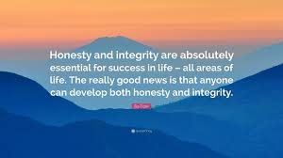

HONESTY AND INTEGRITY

Slide 87
HONESTY AND INTEGRITY
Truthfulness
The standard of truthfulness in engineering is very high, much higher than in everyday life.
Truthfulness imposes an absolute prohibition on deception, and in addition it establishes a high ideal of seeking and speaking the truth.
Truthfulness also imposes that engineers must be objective and truthful and must not engage in deception.
It is interesting to note that all other engineering codes set forth a statement of the truthfulness rule.

Slide 88
HONESTY AND INTEGRITY
Trustworthiness
Trustworthiness centres on respect for autonomy and on meeting responsibilities about trust.
Engineering is based on exercising expertise within trust relationships in order to provide safe and useful products.
Untrustworthiness undermine expertise by corrupting professional judgements and communications.
Untrustworthiness also undermine the trust of the public, employers and others who must rely on engineers’ expertise.

Slide 89
HONESTY AND INTEGRITY
Academic Integrity
Academic dishonesty includes dishonesty among students, faculty and other members of academic institutions.
Study has revealed that among schools lacking a strong honour code, three out of four students admitted to have engaged in academic dishonesty at least once during their college career.
Among the school with honour code, one in two made the same admission.
Academic dishonesty among students takes several forms.

Slide 90
HONESTY AND INTEGRITY
Some forms of academic dishonesty includes:
Cheating: intentionally violating the rules of fair play in any academic exercise for example, by using crib notes or copying from another student during a test.
Fabrication: intentionally falsifying or inventing information, for example, faking results of an experiment.
Plagiarism: intentionally or negligently submitting others’ work as one’s own , for example, by quoting the words of others without using quotation marks and citing source.
Facilitating academic dishonesty: intentionally helping other students to engage in academic dishonesty, for example, by loaning them your work.

Slide 91
HONESTY AND INTEGRITY
Misrepresentation: intentionally giving false information to an instructor, for example, lying about why one missed a test.
Failure to contribute to a collaborative project: failing to do one’s fair share on a joint project.
Sabotage: intentionally preventing others from doing their work, for example, by disrupting lab experiment.
Theft: stealing, for example, stealing library books or other students’ property.

Slide 92
HONESTY AND INTEGRITY
Research Integrity
Research in engineering requires moral ethics, however the exact moral requirements vary somewhat according to the application guidelines and regulations, but the truthfulness responsibility applies in all settings.
Research ethics has many facet which may cover:
Research integrity and misconduct
Conducting and reporting experiments
Protecting research subjects
Giving and claiming credit
Reporting misconduct.

Slide 93
HONESTY AND INTEGRITY
Giving and Claiming Credit
Researchers often compete for professional recognition because it involve winning jobs, promotions and income, however outright fraud of the following types also occur:
Plagiarism (claiming credit for someone else’s ideas or work without acknowledging it, in contexts where one is morally required to acknowledge it).
Misrepresenting credentials (researchers forge credentials, creating widely publicised scandals).
Misleading listing of authorship (it is unethical to omit a co-author who makes a significant contribution to a research).

Slide 94
HONESTY AND INTEGRITY
Reporting Misconduct
Researchers have a responsibility to report misconduct by other researchers when the misconduct is serious and when they are in a position to document it.
Yet typically there are strong pressures from supervisors, colleagues, and others not to report misconduct, and hence most instances fall into the category of whistleblowing.
Measures to protect individuals who responsibly report research misconduct must be implemented and intensified.
More needs to be done to curb the stigma of “turning in” a colleague.

Slide 95
HONESTY AND INTEGRITY
Consulting Engineers
Consulting engineers are engineers who work in private practice. They are compensated by fees for the services they render, not by salaries received from employers.
Because of this they tend to have greater freedom to make decisions about projects they undertake.
Yet their freedom is not absolute; they share in a same light with salaried engineers the need to earn a living.
Consulting engineers have honest roles to play in:
Advertising
Competitive bidding
Contingency fees

Slide 96
HONESTY AND INTEGRITY
Advertising
Corporate engineers are involved in advertising because they work in product sales divisions.
Consulting engineers are directly responsible for advertising their services, even when they hire consultants to help them.
It is difficult to determine whether specific ads are deceptive or not, however it is clearly deceptive for a consulting firm to claim in a brochure that it played a major role in a well-known project when it actually played a minor role.
Consumer products advertisers, are generally allowed to suppress negative aspects of the items they are promoting and to engage in some degree of exaggeration of the positive aspects.

Slide 97
HONESTY AND INTEGRITY
Competitive Bidding
Competitive bidding is competing for jobs on the basis of submitted priced proposals.
Clients do not rely exclusively on reputation and proven qualification in choosing engineering firms for contracts but also on price attached to the proposals.
This raises the problem of how the qualifications are to be determined in an equitable way.

Slide 98
HONESTY AND INTEGRITY
Contingency Fees
Contingency fee is a fee that is payable only if the outcome is successful or the outcome saves the client money.
Consulting engineers essentially make their own arrangements about payment for their work. Naturally this calls for exercising a sense of honesty and fairness.
In contingency fee situations, the consultant’s judgement may easily become biased.
For example, the prospects of winning the fee may tempt the consultant to specify inferior materials in order to cut constructing costs.

Slide 99
HONESTY AND INTEGRITY
Expert Witness and advisers
Engineers increasingly are asked to serve as consultants who provide expert testimony in adversarial or potentially adversarial contexts.
Usually engineers are hired by one adversary in the dispute , and that raises special ethical concerns about their proper roles.
These engineers should function as impartial seekers and communicators of the truth.
They become ‘hired guns’ when they are paid to tell one side of the story.

Slide 100


ENGINEERS AND TECHNOLOGICAL PROGRESS

Slide 101
ENGINEERS AND TECHNOLOGICAL PROGRESS
Optimism, Pessimism, Realism
Both values and facts are involved in assessing when technological change constitutes technological progress.
Progress means advancement toward valuable goals, hopefully using permissible means.
Typically, debates between optimists and pessimists turn on more than disagreements about the facts and estimates of risk.
They involve differing judgements about moral values, especially values of social justice, human fulfilments, and respect for the environment.

Slide 102
ENGINEERS AND TECHNOLOGICAL PROGRESS
Technology: Value-Neutral or Value-Laden
According to value-neutral view, technology consists of artifacts or devices - machines, tools, structures, perhaps together with knowledge about how to make and maintain devices. As such, it is neither good nor bad, but merely a means that can be used for good or bad purposes.
According to value-laden view, technology consist of more than artifacts and knowledge, but also the organisations and general approaches that make technological development possible, and organisations and approaches are guided by values.

Slide 103
ENGINEERS AND TECHNOLOGICAL PROGRESS
Shared Responsibility and Control of Technology
Technological determinism is the thesis “that technological somehow causes all other aspects of society and culture, and hence that changes in technology dictate changes in society.”
In a strong version, the thesis of technological determinism denies human choice: We are victims of technology rather than in control of it.
Technological determinism undermines shared responsibility for technological projects.
For responsibility presupposes freedom, engineers are not responsible for changes that are entirely beyond human control.

Slide 104
ENGINEERS AND TECHNOLOGICAL PROGRESS
Uncertainty, Ambiguity, and Social Experimentation
Uncertainty about general trends in technological change, as well as about specific technologies, lies at the heart of debates about technological optimism.
Although the pace of scientific and engineering advancement is breath-taking, there is a lag in moral, social and political understanding.
The model of engineering as social experimentation highlights this dimension of engineering, whatever one’s specific beliefs about the relevant facts concerning technological change.

Slide 105
ENGINEERS AND TECHNOLOGICAL PROGRESS
Moral Leadership
As managers, business entrepreneurs, corporate consultants, academics, and government officials, engineers provide many forms of leadership in developing and implementing technology.
In this case technology is understood broadly to include artifacts, knowledge, organisations and approaches.

Slide 106
ENGINEERS AND TECHNOLOGICAL PROGRESS
Morally Creative Leaders
Leadership is an achievement word which indicates success in ,moving a group toward goals.
Moral leaders are individuals who direct, motivate, organise, creatively manage, or in others ways move groups toward morally valuable goals.
Moral leadership means employing morally permissible means to stimulate groups to move toward morally desirable ends.
Moral leaders are morally creative, identifying the most important values that apply in a particular situation, bringing them into focus through effective communication within groups, and forming workable commitments to implement them.

Slide 107
ENGINEERS AND TECHNOLOGICAL PROGRESS
Participation in Professional Societies
Moral Leadership within engineering is often manifested in leadership within professional societies.
Professional societies do more than promote continuing education for their members.
Professional societies provide a forum for communicating, organising and mobilising change within and by large groups.
Individuals also have spurred professional societies to foster the study of engineering ethics.

Slide 108
ENGINEERS AND TECHNOLOGICAL PROGRESS
Ideals of Voluntary Service
Voluntary Service is certainly a vital avenue for providing moral leadership within communities.
By sharp contrast, most engineering codes of ethics have been silent on this issue or taken stands that discourage volunteerism.
It is important that, morally concerned engineering profession should recognise the rights of corporations and individual engineers to voluntary engage in philanthropic engineering service.

